Slide 1
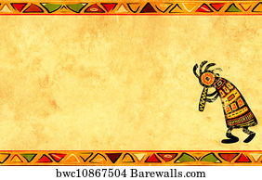
AFRICA QUIZ
Girls night IN 2020

Slide 2
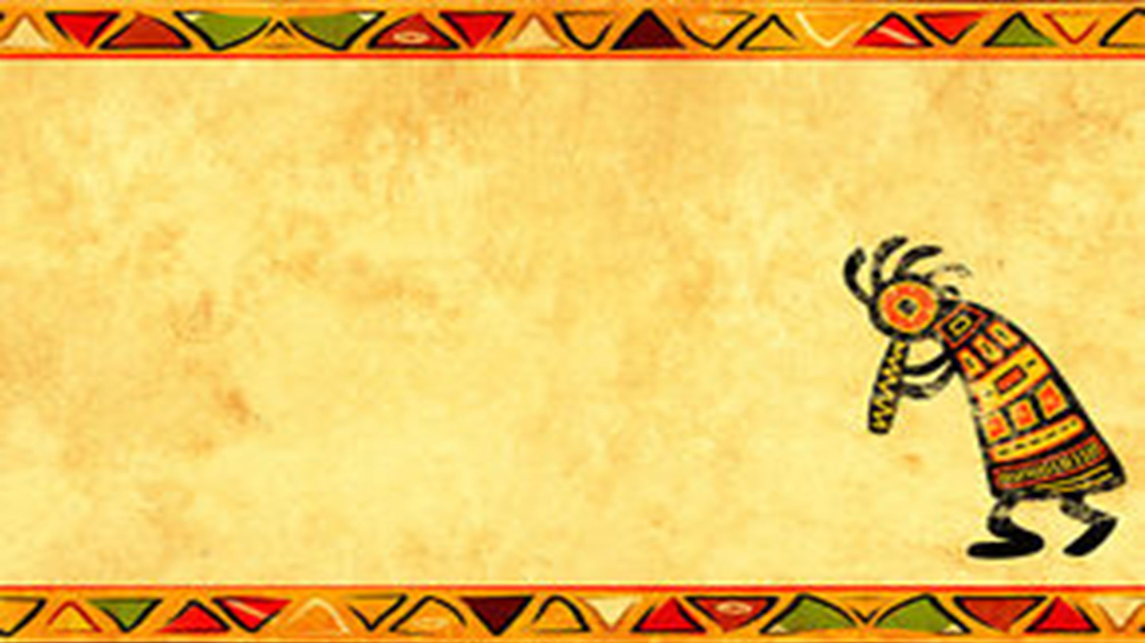
Question 1:
Which is the most populated country in Africa?
Nigeria
South Africa
Kenya

Slide 3
Question 2:
Which band released the song ‘Africa’ in 1981?

Slide 4
Question 3:
What is the highest city in Africa by altitude?
Cape Town
Addis Ababa
Cairo

Slide 5
Question 4:
Which Moroccan city is the title of a 1942 film?

Slide 6
Question 5:
What is the biggest African country by size? (land mass)
Ethiopia
Algeria
South Africa

Slide 7
Question 6:
What is the highest mountain in Africa?

Slide 8
Question 7:
Unscramble this African country anagram; YANKE

Slide 9
Question 8:
In what year was Nelson Mandela released from prison?
a)1984
b)1998
c)1990

Slide 10
Question 9:
Afrikaans, spoken in South Africa, is a variant of which European language?

Slide 11
Question 10:
What name is given to the Cape, that is the southern most point of Africa?

Slide 12
ANSWERS

Slide 13
Question 1:
Which is the most populated country in Africa?
a) NIGERIA

Slide 14
Question 2:
Which band released the song ‘Africa’ in 1981?
TOTO

Slide 15
Question 3:
What is the highest city in Africa by altitude?
b) ADDIS ABABA

Slide 16
Question 4:
Which Moroccan city is the title of a 1942 film?
CASABLANCA

Slide 17
Question 5:
What is the biggest African country by size? (land mass)
b) ALGERIA

Slide 18
Question 6:
What is the highest mountain in Africa?
KILIMANJARO

Slide 19
Question 7:
Unscramble this African country anagram; YANKE
KENYA

Slide 20
Question 8:
In what year was Nelson Mandela released from prison?
c) 1990

Slide 21
Question 9:
Afrikaans, spoken in South Africa, is a variant of which European language?
DUTCH

Slide 22
Question 10:
What name is given to the Cape, that is the southern most point of Africa?
CAPE OF GOOD HOPE

